Slide 1
Text Analysis with Convolutional Neural Nets

Slide 2
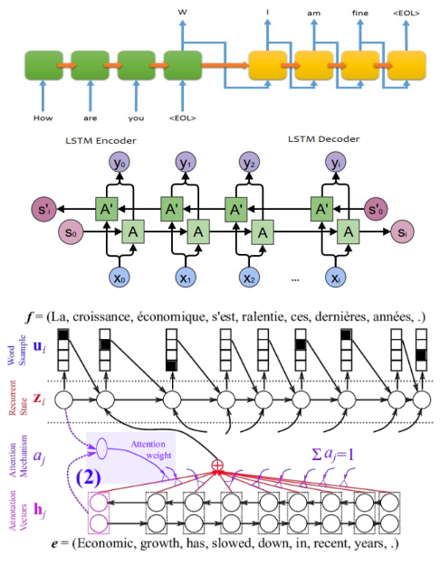
What is currently used?
The “go-to” for Text analysis right now is Recurrent Neural Networks:
Slow (er than CNNs)
Cannot parallelize RNNs
Reads the words sequentially
Complicated (if you want the whole sentence to be considered in computation)
Long term and backward dependencies imply almost double the computation
Needs streamed sentences
Notes:
Current go-tos in the field is RNN
They’re good because they

Slide 3
Why use Convolutional Neural Nets for Text?
Faster than RNNs
CNNs have a larger receptive field (area of “vision” each neuron can see)
Have a lot of knowledge and tools from the field
Local invariance is useful for applications like Sentiment Analysis
Compositionality of structures is inherent in grammar.
And because why not?

Slide 4
How do we convert some text into a 2D format?
We use some word embedding systems such as
One-Hot Representations
BoW : Bag of Words
Word2Vec
GloVe: Global Vectors

Slide 5
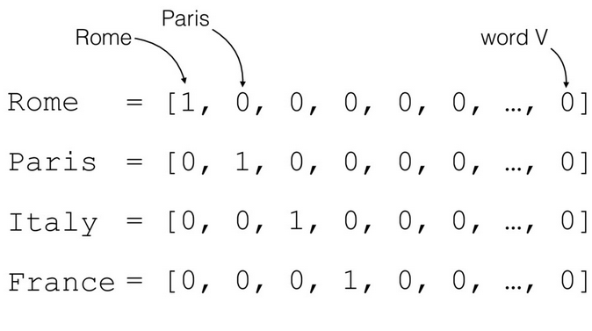
One Hot Representation Quickly Explained
Trivial way of representing words
Not always the most intuitive or helpful format
Good as a base to start from
Dimensions depend on the vocabulary.
Doesn’t keep track of position of words

Slide 6
Word2Vec Quickly Explained
Properties of Word2Vec:
Keep context of surrounding words
Find common phrases in a vocabulary
Creating a more compact representation of words and phrases.
Embedding is created using a simple feed forward neural net
Achievements of word2vec:
Encoding semantic properties of words into the representations
Allowing for a mapping of relations in the corpus via a vector space of high dimensions.

Slide 7
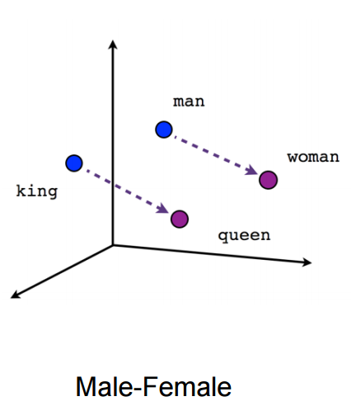
Word2Vec Advantages
Allows for algebraic operations through the vector representations
w2v(King) = w2v(Queen) - w2v(woman) + w2v(man)
Is valid.
Applications of Word2Vec:
Semantic Relations
Word Suggestions
Language Translations
Aim/Applications of a Skip-Gram word2vec model:
Given Context, return the missing word!
Notes:
Versions of word2vec:
Continuous Bag of Words: w2v({context}) -> Return: targetWord
Skip-Gram: w2v(word) -> return: {context}

Slide 8
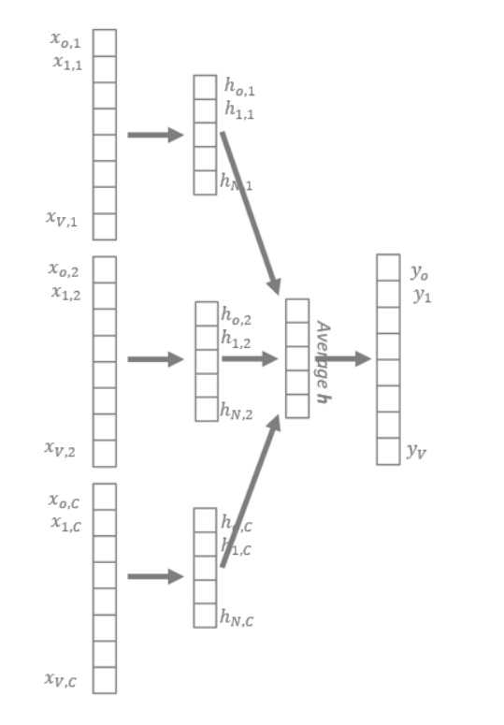
Word2Vec Quickly Explained: How it works? (Skip-Gram)
“I love baked potatoes”
Goal : Find the embedding of “baked”
Run “i love potatoes” through a pretrained word2vec NN
Extract the one-hot representation of the word “baked”
Peel away the final layer of the network, and focus on the weights from the hidden layer
Weights in the hidden layer are used as the embedding

Slide 9
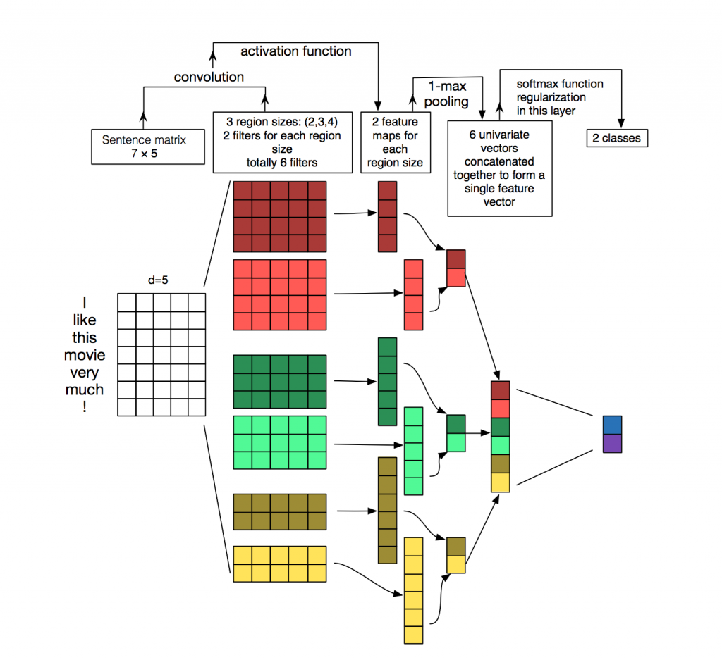
Embedding to 2D (word2vec)
How to turn a sentence into 2D
Take the vector representation of each word in the sentence (d)
Take all the words in the sentence (n)
Create a matrix of size (n x d) which represents the sentence
Notes:
http://www.wildml.com/2015/11/understanding-convolutional-neural-networks-for-nlp/

Slide 10
Convolution on a text based matrix
Convolutions are done over the whole width of the matrix
Filters are of different sizes (n-gram distances)
Max Pooling is often done over the whole feature map
Softmax like functions bring down number of classes
Notes:
Ref : http://www.wildml.com/2015/11/understanding-convolutional-neural-networks-for-nlp/

Slide 11
Text CNNs Filters
Different sizes of filters
Width = width of embedding
Height = number of words wanted in the receptive field
Capture different aspects of the sentence
For example:
Size 2 filter: captures a negation “not amazing”
Size 4 filter: captures a target “potatoes are not amazing”

Slide 12
Text CNNs Pooling: The “not amazing” example
Max Pooling is done after Convolutions
Max Pooling Reduces dimensionality
Obtains the core features of a sentence
Max pooling is done over the whole filter
Negation Example:
In a sentence that contains “not amazing” as a phrase, we want to obtain the core idea that the sentence has a negation in it. We max pool to extract that information, rather than ‘noise’ in the rest of the sentence. (which is picked up by other filters)

Slide 13
Text CNNs Large Receptive Fields
A great advantage of using CNNs is large receptive fields
Various sizes of filters grab a large range of details
Max pooling removes noise that exists in text (“is,the”)
Allows the final layers to use information from each part of the sentence, and keep the context at the end influence the start of the sentence’s meaning.
Notes:
K -m ax pooling
Wide/narrow convolutions
Cool best ofl uck boi

Slide 14
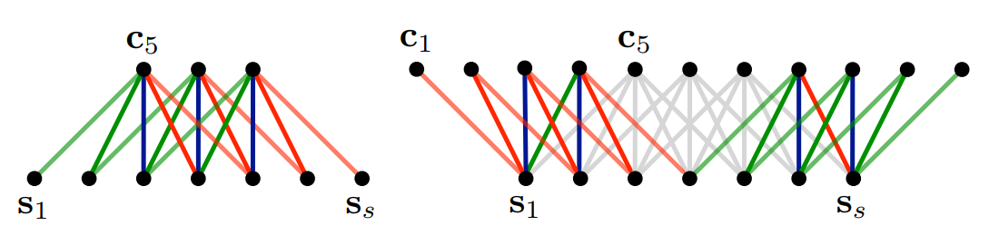
Hyper Parameters of CNNs
Various stride sizes allow us to mimic properties of a RNN, where we have large overlaps between contexts creating internal tree structures
Wide / Narrow Convolutions: Allow us to alter how much of the embedding we want to use. Weighing certain relations and properties more than the others

Slide 15
Convolution on Images vs Text
Images
Convolution helps local pixels
Local Invariance is important (wherever the stop sign is in the image)
RGB Channels in images
Large receptive field to understand
Text
Convolution helps nearby words
Local invariance is important for sentiment / topic analysis
Channels can be different embedding systems or languages

